Slide 1





Indian Agriculture Analysis project
Made By Ahmad Ali Alsheikh Ahmad

Slide 2

Project Objectives
1. Data Exploration
2. Crop-specific Analysis
3. Regional Disparities
4. Seasonal Patterns
5. Fruits and Vegetables Analysis
6. Impact of External Factors
7. Sustainable Farming Insights

Slide 3
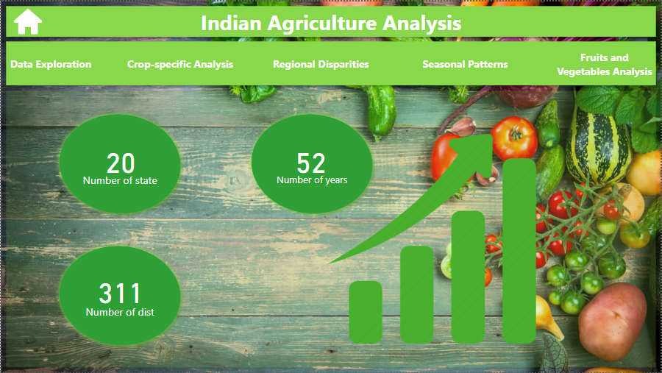

Slide 4


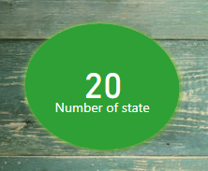
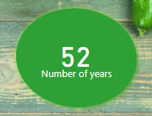
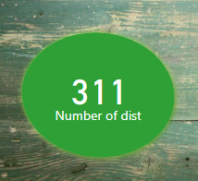
Home
Number of state
Number of years
Number of dist

Slide 5
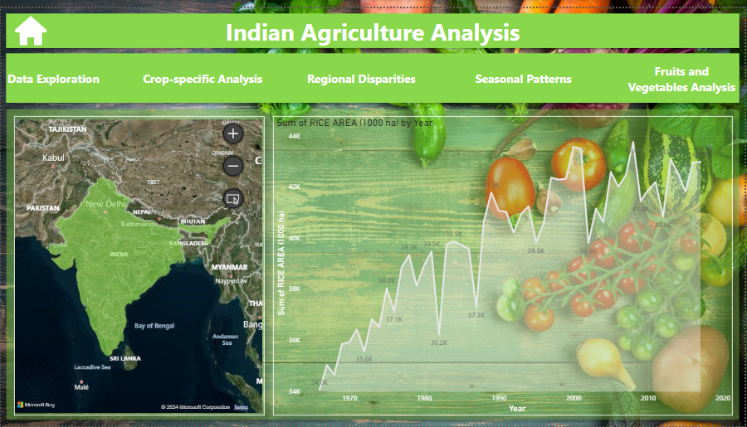


Slide 6
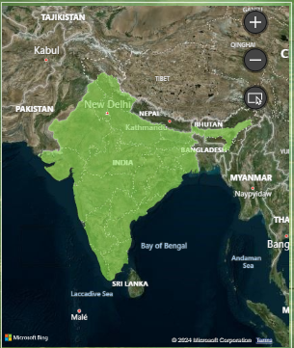
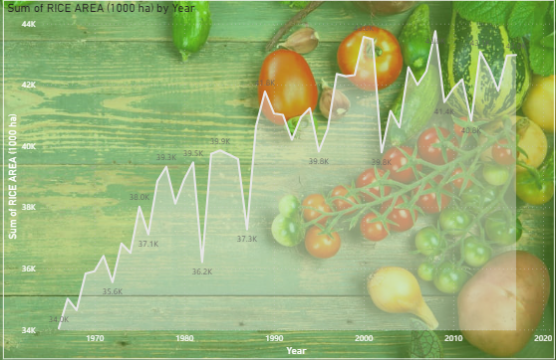

Data Exploration
Distribution of agricultural areas in India.
Distribution of rice area across years.

Slide 7
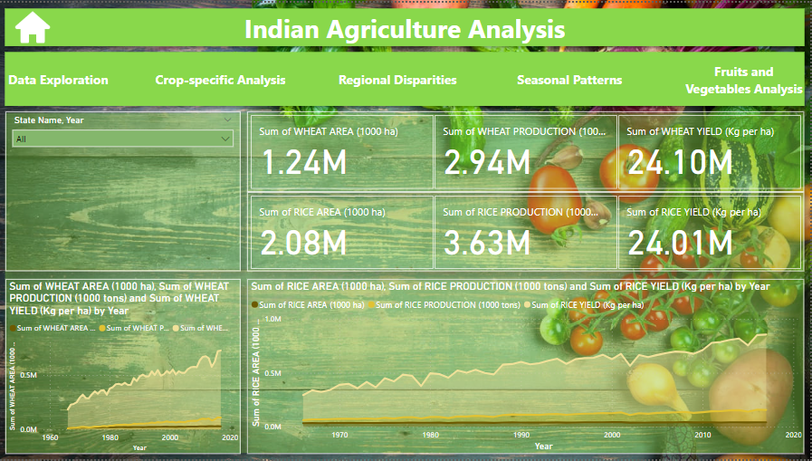

Slide 8
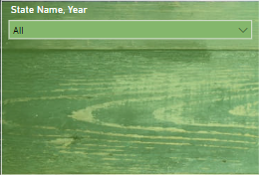
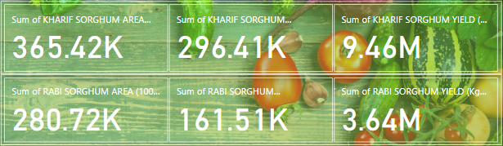
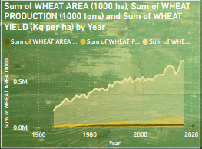
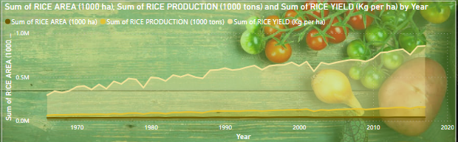
Crop-specific Analysis
search bar for select state name and year

Slide 9
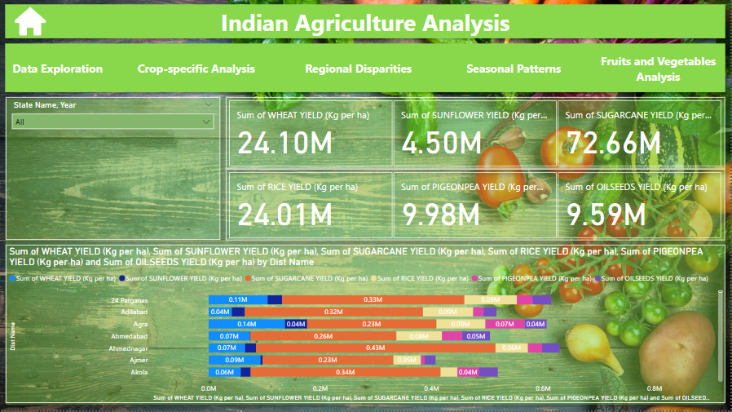

Slide 10
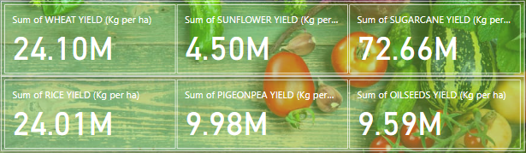
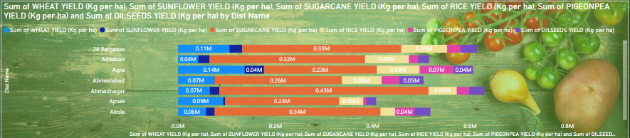
Regional Disparities
search bar for select state name and year
Total of each product across different districts and states.

Slide 11
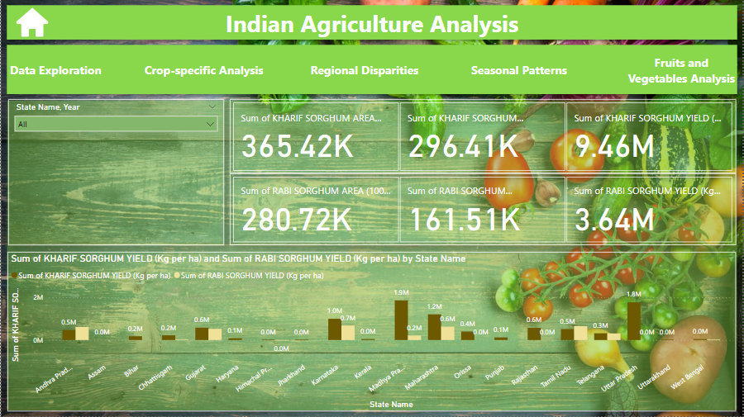

Slide 12
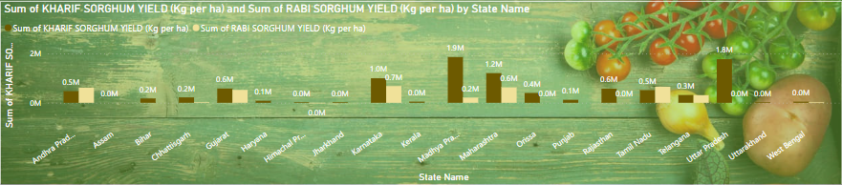
Seasonal Patterns
search bar for select state name and year
seasonal patterns in crop cultivation during kharif and rabi seasons.

Slide 13
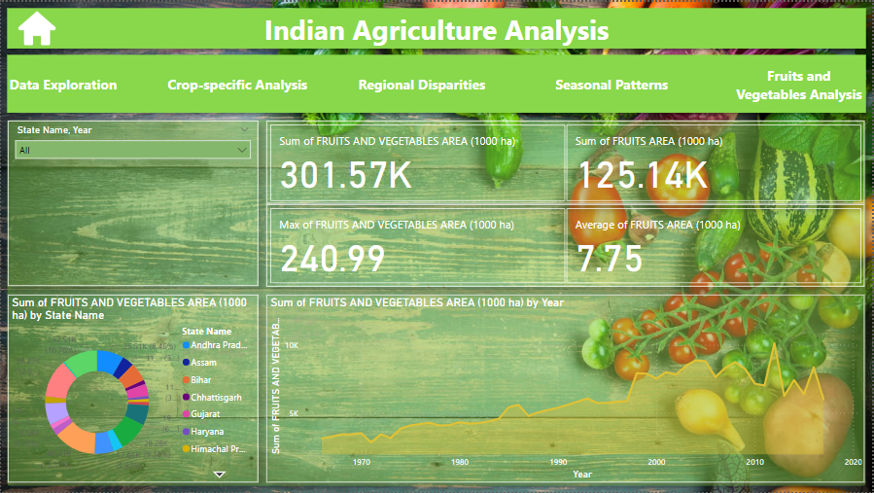

Slide 14
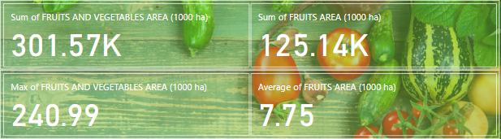
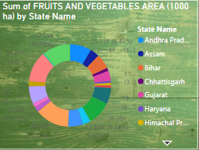
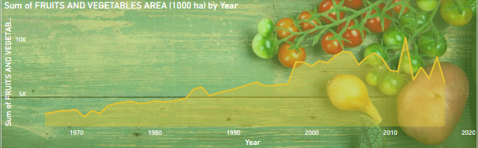
Fruits and Vegetables Analysis
search bar for select state name and year
Distribution of fruits and vegetables area by state name .
Distribution of fruits and vegetables area by years.

Slide 15

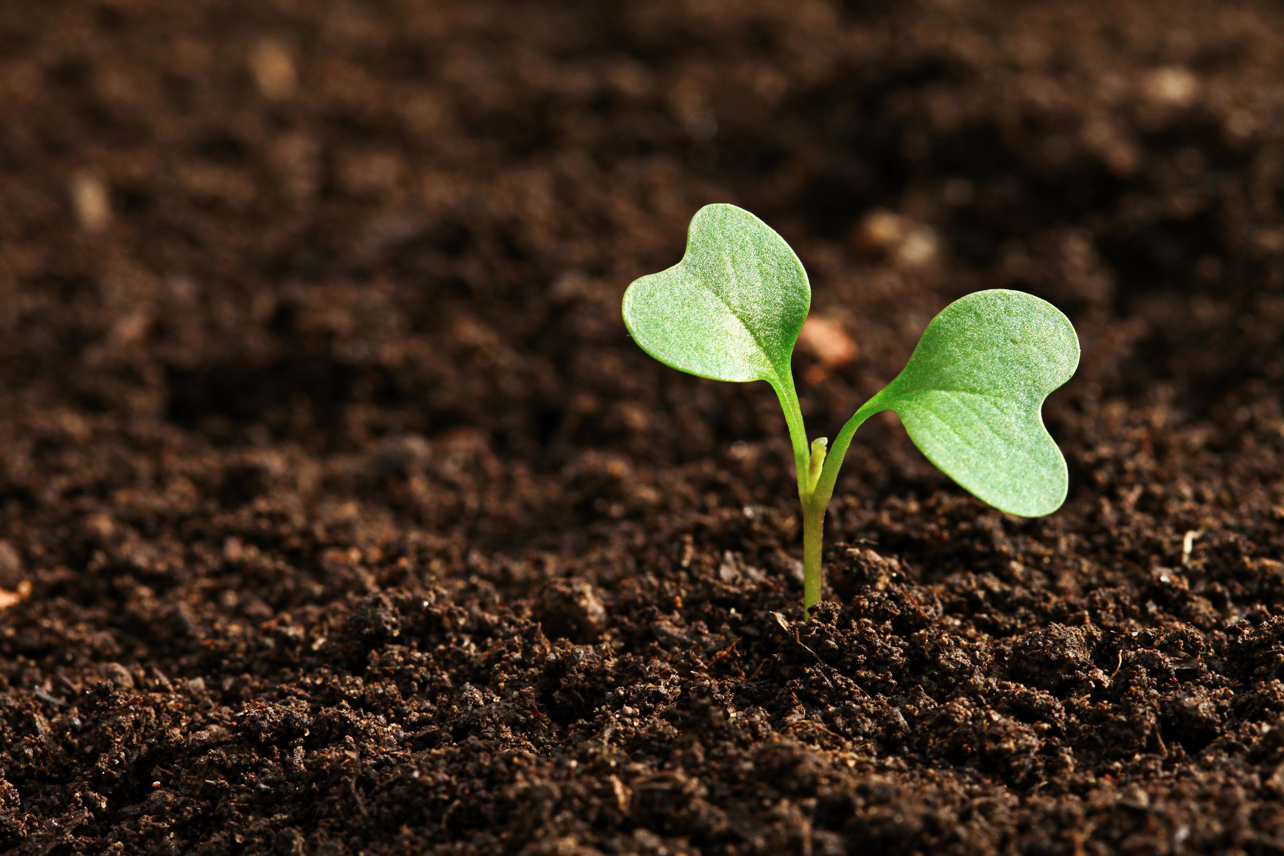
Impact of External Factors
Weather impacts may have direct or indirect influence on the performance of agricultural production and food industry. Water availability can be considered as a basic factor related to yield quality and quantity performance of crops, based on the data ,we noticed an increase in crop production in the kharif season compared to the Rabi season in varying proportions .Yield stability of crops may be highly variable according to weather impacts.

Slide 16

Sustainable Farming Insights
Using artificial intelligence in the sensors on sprinklers by programming them to measure soil moisture. If it is less than the normal rate, the sprinklers are turned on automatically. However, if the humidity is appropriate, do not turn on the sprinklers. This is how we can contribute to maintaining the appropriate humidity for crop growth and guidance in Water consumption is done by programming sprinklers and sensors to operate within their specified humidity levels. This structure can be used to deliver pesticides and the resources necessary to maintain soil fertility. In this case, the contribution lies in maintaining both moisture and soil fertility.

Slide 17
Thank you!

